Slide 1


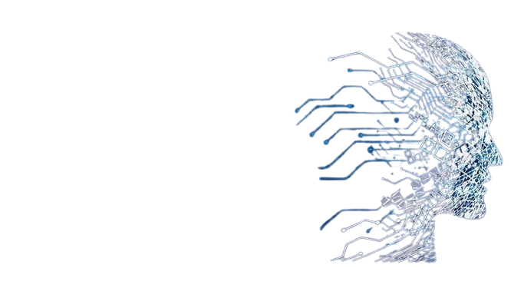
M.Sc. Applied Mathematics
School of Emerging Science & Technology
Gujarat University, Ahmedabad
AMS Sem – 4
Project presentation
Milansinh Gohil :- 06
Yashkumar Joshi :- 33

Slide 2
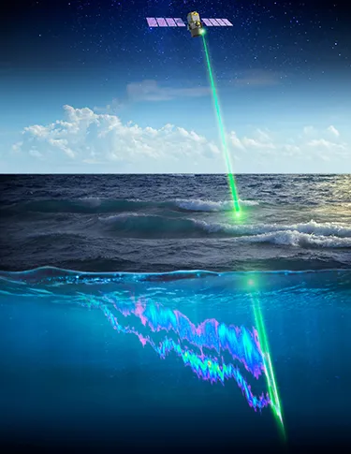

Problem statement
Prediction of sea surface currents by using Deep neural network and satellite observations of sea surface winds, height and temperatures in the North Indian Ocean.
Mentor : Jaikumar Pundir

Slide 3
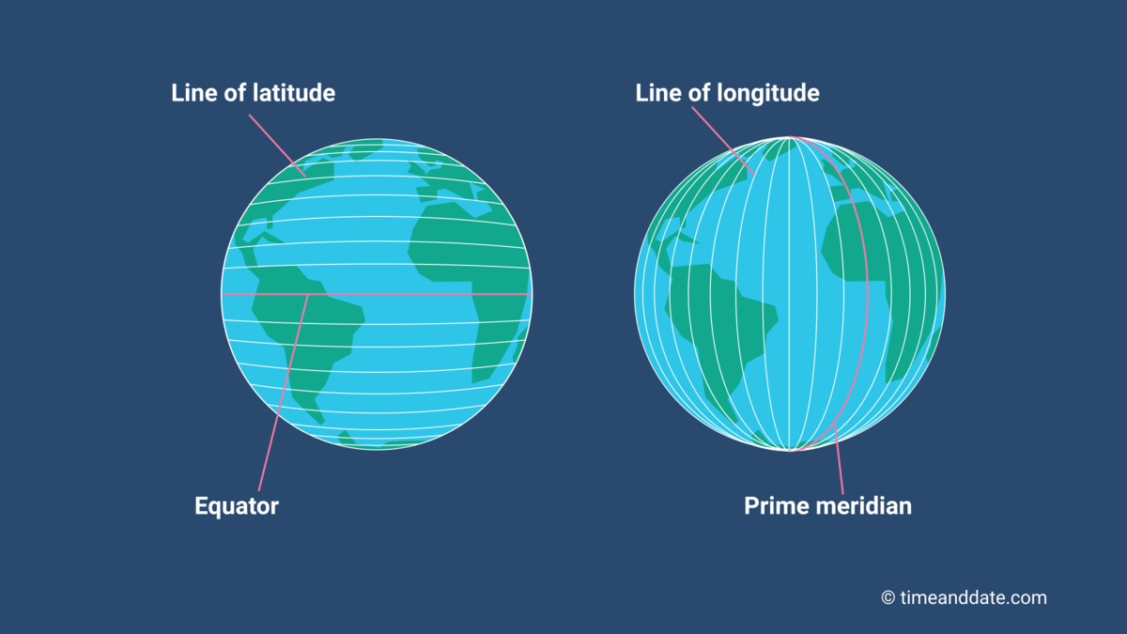
Basics about data
We have 4 columns in our data Time, Longitude, Latitude, ADT
Which are important parameters for our data
Latitude: Lines that run east-west, showing how far north or south a place is from the equator.
Longitude: Lines that run north-south, showing how far east or west a place is from the Prime Meridia
Together, they create a grid to pinpoint any location on Earth.
Time: Time changes when you cross time zones, but your longitude and latitude remain the same, keeping your exact location on Earth unchanged.

Slide 4
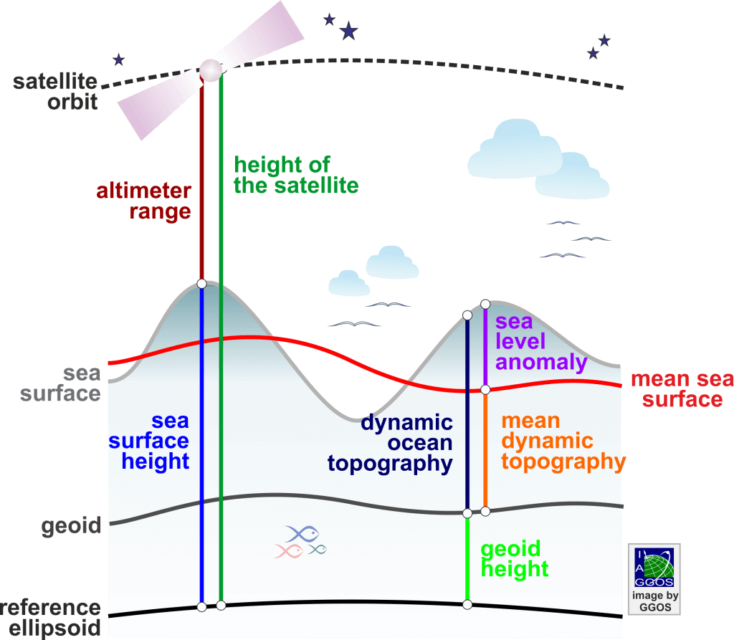
ADT (Absolute Dynamic Topography)
It measures the height of the sea surface compared to a reference level (geoid), showing ocean currents.
Higher ADT means warmer, less dense water
lower ADT means cooler, denser water.
The absolute dynamic topography is the sea surface height above geoid the adt is obtained as adt = sla + mdt
Absolute
SSH: Sea Surface Height
SLA: Sea Level Anomaly
MSS : Mean Sea Surface
MDT : Mean Dynamic Topography

Slide 5
Why .nc files?
A .nc file is a NetCDF file, which is a format for storing scientific data. NetCDF stands for Network Common Data Form.
We have a datafile in .nc format so let’s see what do we know about .nc files.
.nc files can store a variety of scientific data in a structured and efficient way.
Multidimensional data (e.g., time, depth, latitude, longitude).
Variables (e.g., temperature, wind speed).
Metadata (e.g., units, descriptions).
Gridded data (e.g., maps, satellite images).
Large datasets efficiently.
Perfect for climate, weather, and ocean data

Slide 6
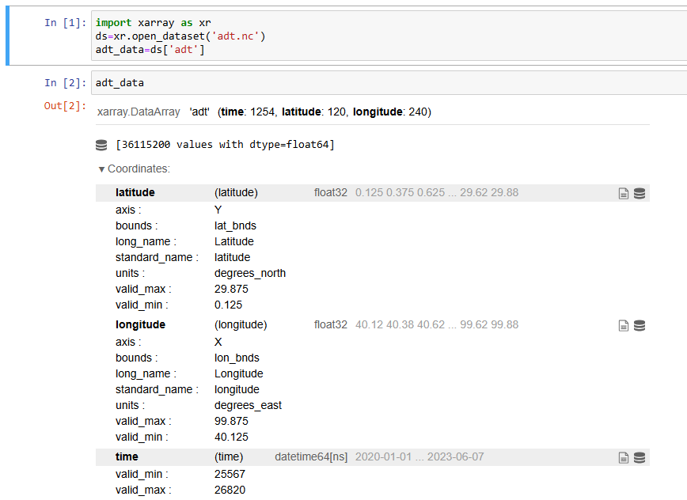
What is Xarray?
Xarray is Python library for working with labeled multi- dimensional data, like .nc files.
Xarray makes it easy to handle complex datasets.
(e.g., Time, latitude, longitude)
To import .nc file as shown in code,
This lodes the data into a structured
format for easy analysis
Benefits
Simple to use.
Great for visualizing and analyzing Ocean, Weather, or Climate data.

Slide 7
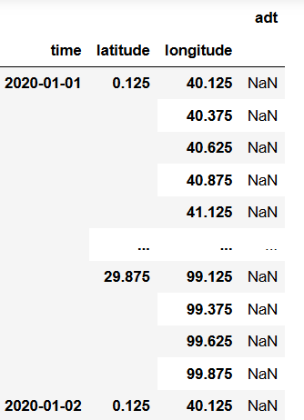
Data Description
Here we have, Columns : 4, Rows : 36,115,200
As we can see this is Time series data.
In data as we can see we have time & for that particular time we have different values of latitude , longitude & adt
For particular 1 day of time we have 120 values of latitude & for 1 value of latitude we have 240 values of longitude .
so , for one value(day) of time we have
(120 × 240 = 28800) rows. & same amount
of adt values
We have the data of 1254 values(days) of time.
so, we have total rows (1254 × 28800 = 36,115,200)

Slide 8
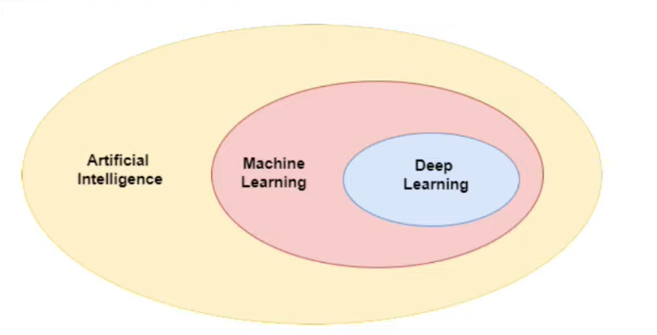
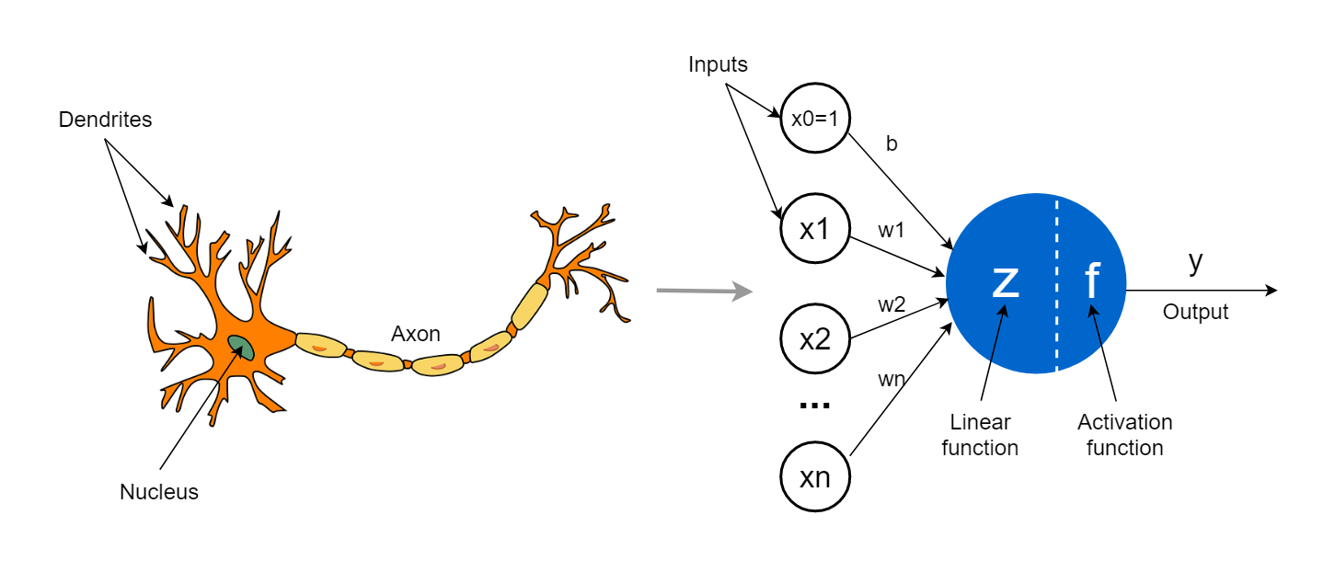
What is Deep Learning?
Deep learning is a subfield of Artificial Intelligence and Machine Learning that is inspired by the structure of a human brain.
Deep learning algorithms attempt to draw similar conclusions as humans would by continually analyzing data with a given logical structure called Neural Network.

Slide 9
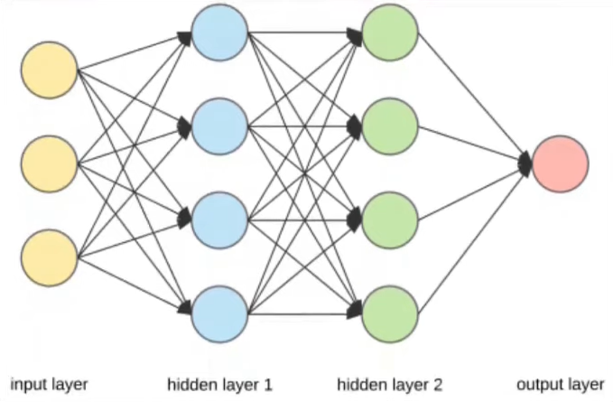
What is Deep Learning?
Deep learning is part of a broader family of machine learning methods based on artificial neural networks with representation learning.
Deep learning algorithms uses multiple layers to progressively extract higher-lavel features from the raw input. For example, in image processing, lower layers may identify edges, while higher layers may identify the concepts relevant to a human such as digits or letters or faces.

Slide 10
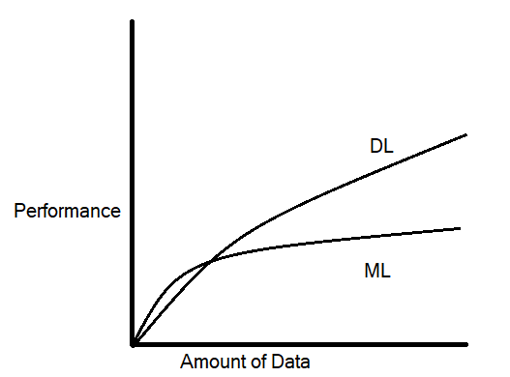

Deep Learning VS Machine Learning
Data Dependency
1
2
Hardware Dependency
Training Time
3
4
Feature Selection
Interpretability
5

Slide 11
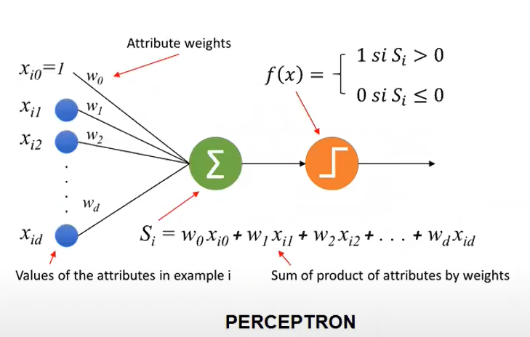
Perceptron
Perceptron is a mathematical model or we can say it is an algorithm. It works for supervised learning.
Because of it’s design it automatically became a building block of deep learning.

Slide 12
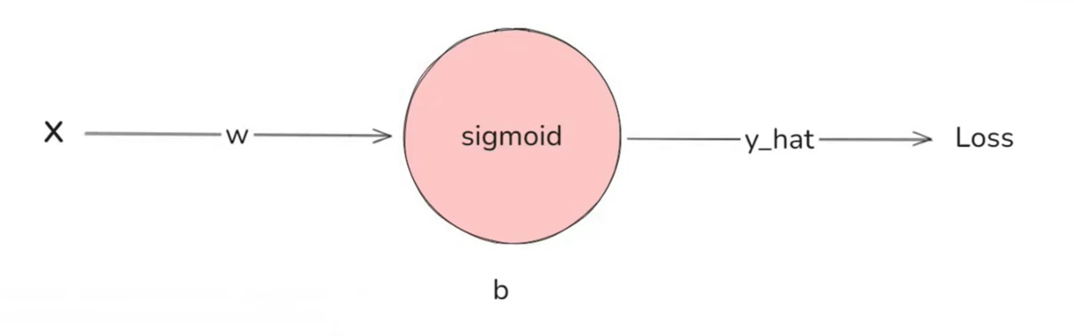
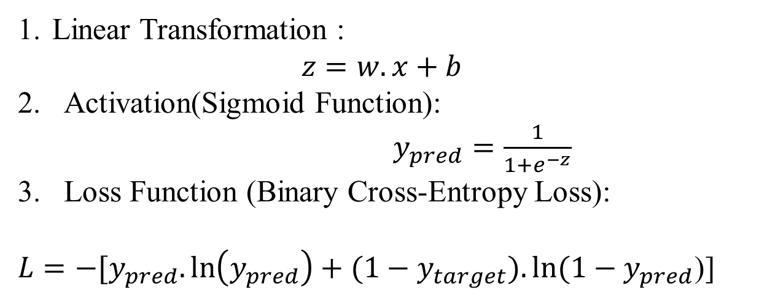
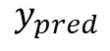
Perceptron Back Propagation
CGPA | Placed
9.11 | 1
8.9 | 1
7 | 0
6.56 | 1
4.56 | 0
$$y_{pred}$$
Forward Pass Computation
Training process
Linear Transformation :
$z=w.x+b$
Activation(Sigmoid Function): $y_{pred}=\frac{1}{1+e^{−z}}$
Loss Function (Binary Cross-Entropy Loss):
$L=−[y_{pred}.\ln\left(y_{pred}\right)+(1−$ $y_{target}).ln⁡(1−y_{pred}$)]
Forward Pass
Calculate Loss
Backward Loss
Update Gradients

Slide 13
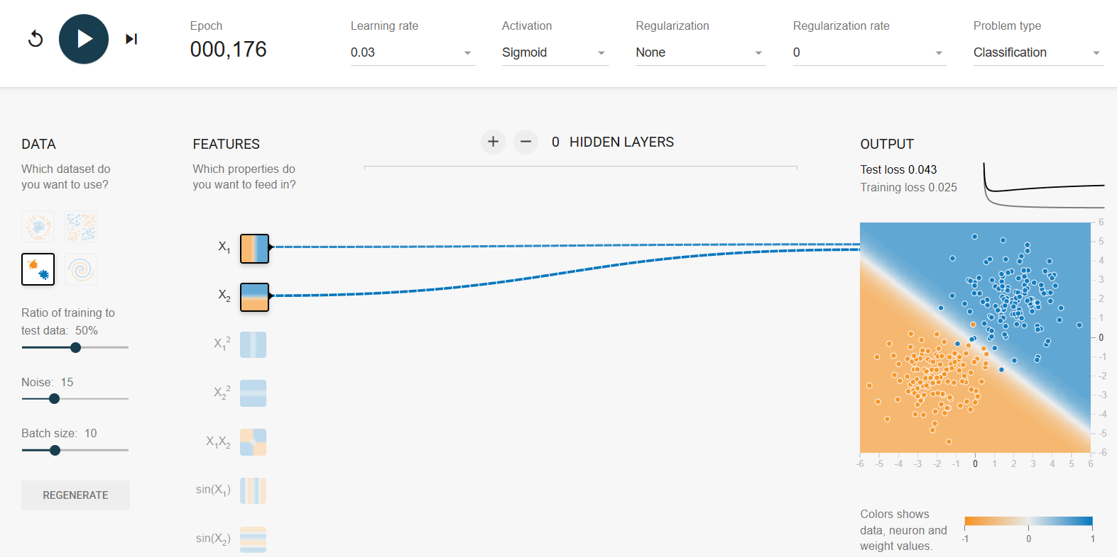
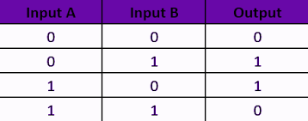
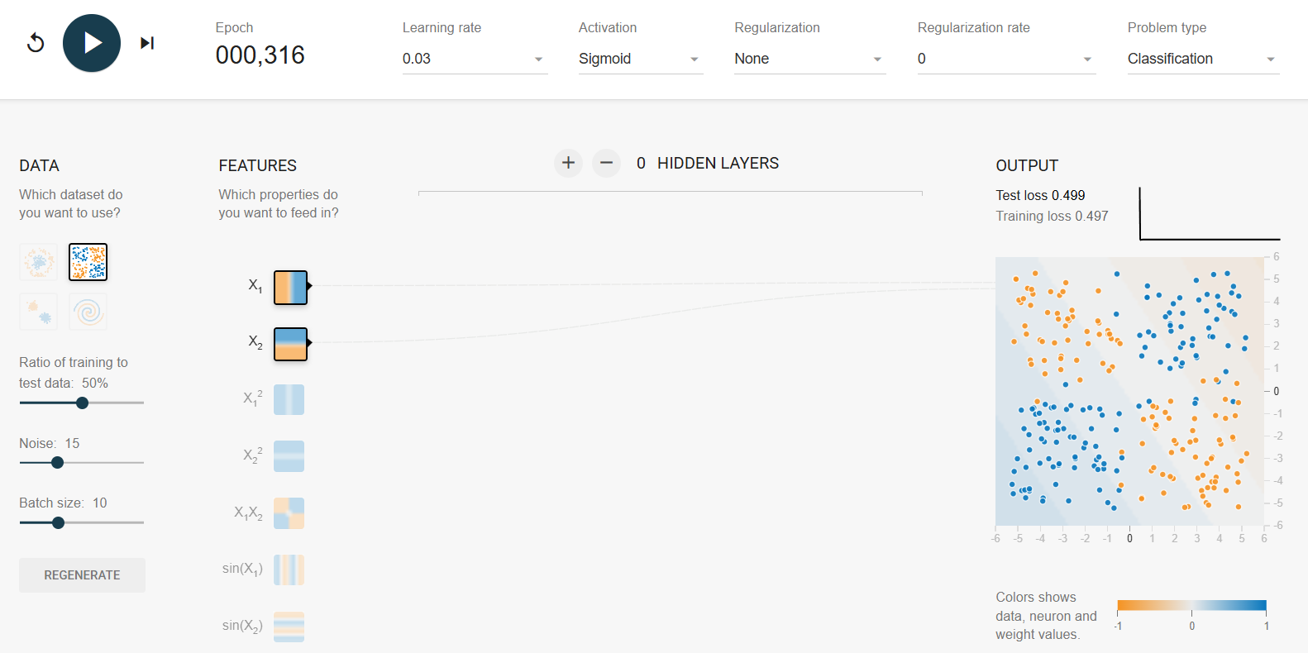
Problem with Perceptron
The perceptron performs well with linear data, but struggles significantly with non-linear data, leading to prediction issues.
XOR Data:
https://playground.tensorflow.org/

Slide 14
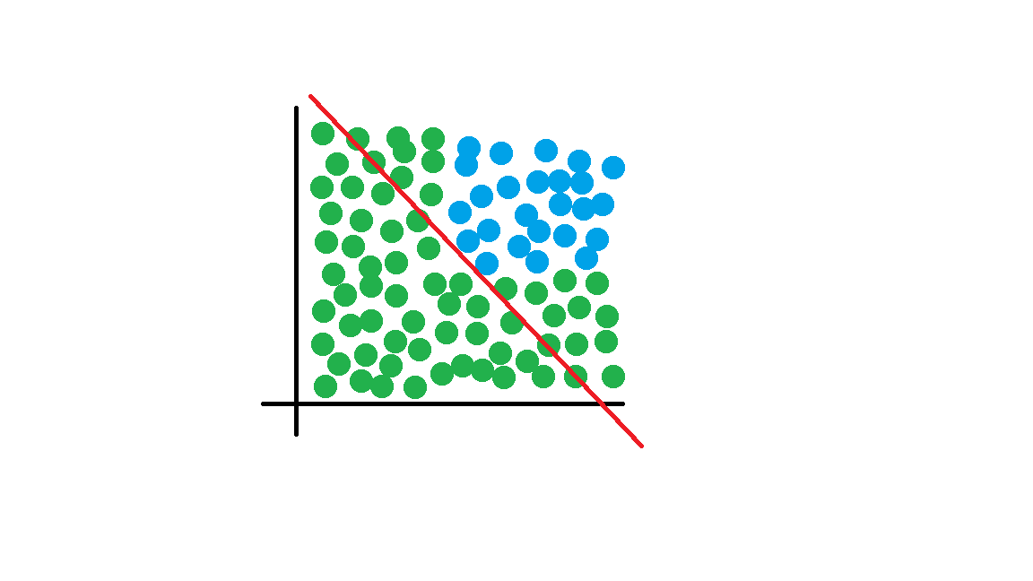
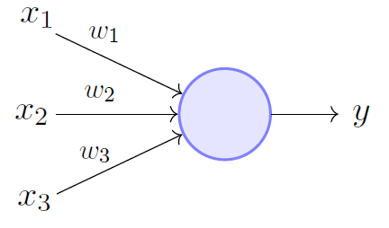
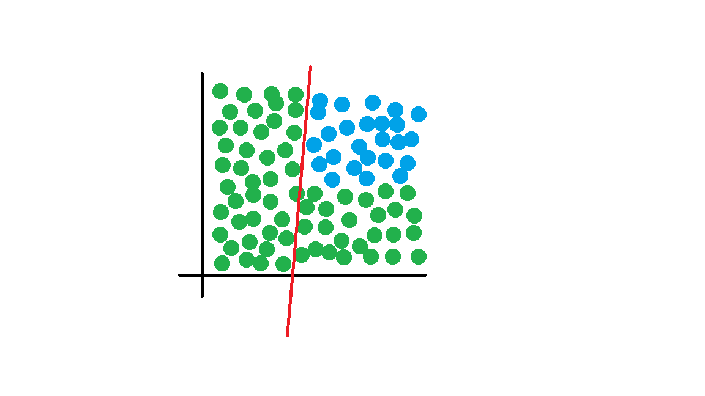
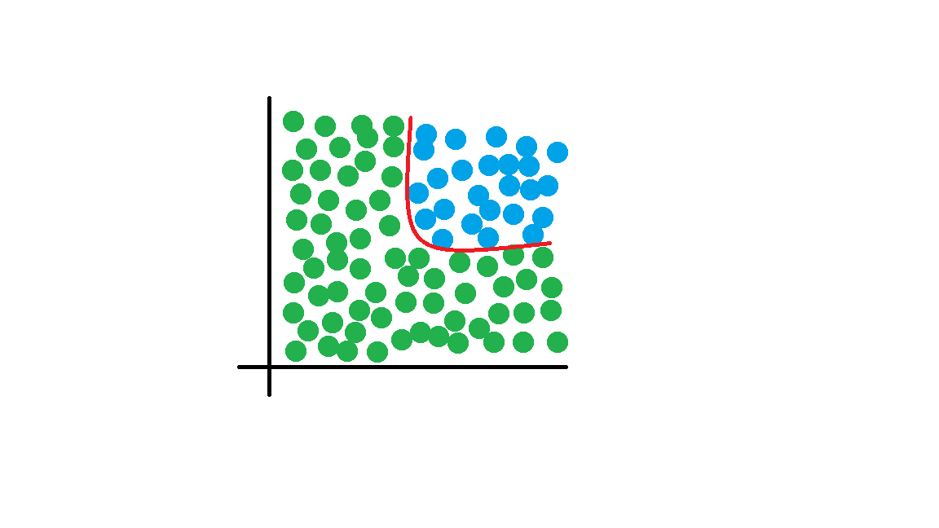
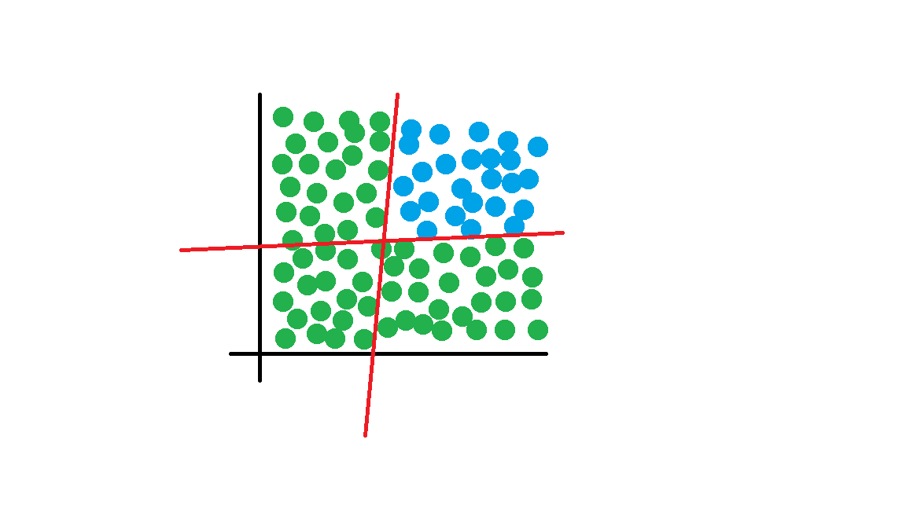
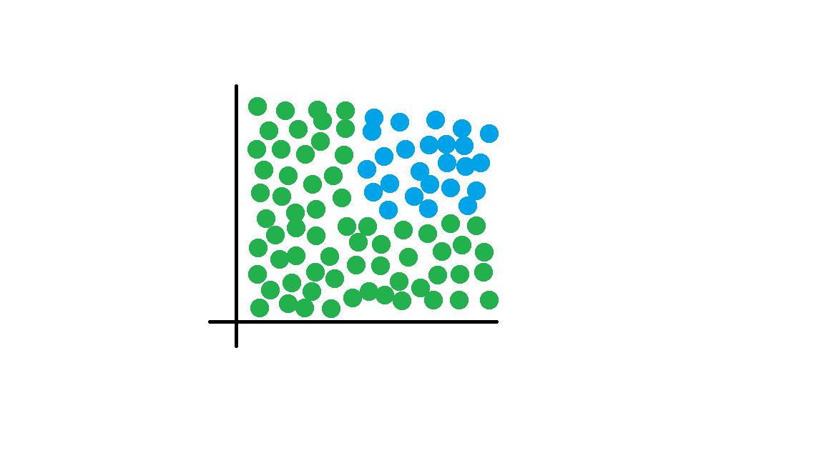
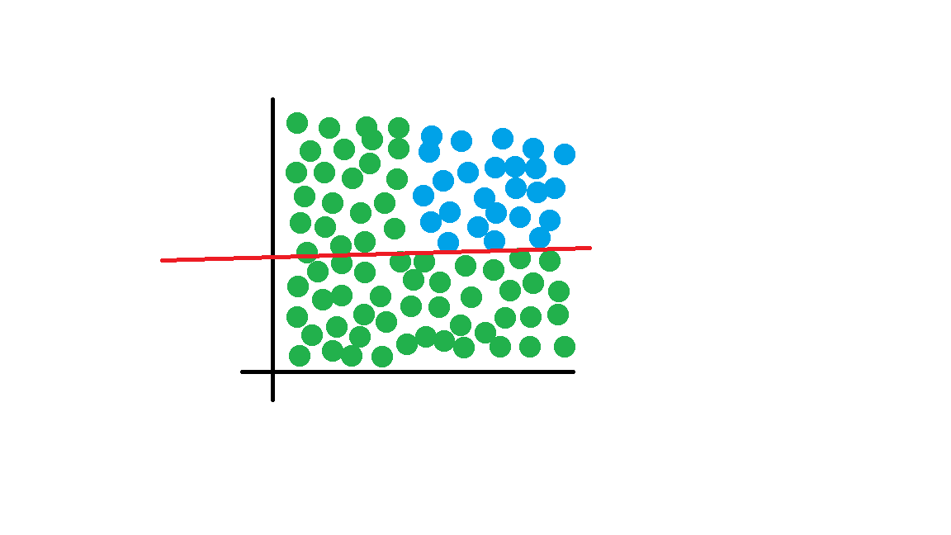
ANN (Artificial Neural Network)

Slide 15
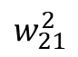
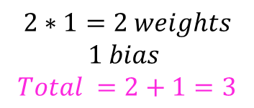
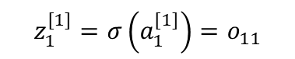
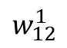
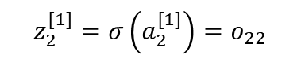
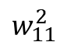
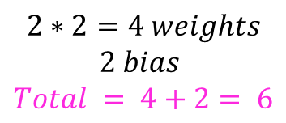
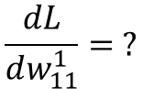

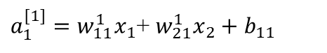
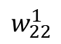
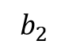
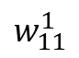
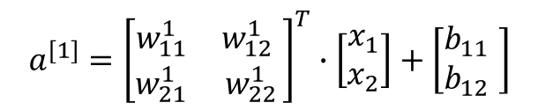
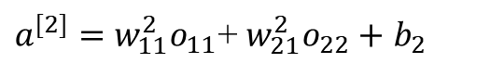
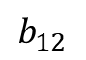
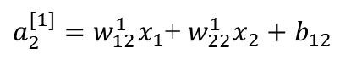
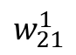
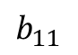
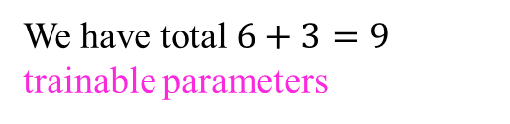
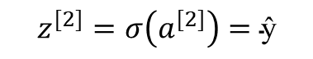
ANN Architecture, Forward & Backward Pass
Forward propagation
Bias
Layer-1
We have total $6+3=9$ trainable parameters
$$a^{[1]}={\left[\begin{matrix}w_{11}^{1} & w_{12}^{1} \\ w_{21}^{1} & w_{22}^{1}\end{matrix}\right]}^{T}∙\left[\begin{matrix}x_{1} \\ x_{2}\end{matrix}\right]+\left[\begin{matrix}b_{11} \\ b_{12} \end{matrix}\right]$$
$$b_{11}$$
$a_{1}^{[1]}=w_{11}^{1}x_{1}$+ $w_{21}^{1}x_{2}+$ $b_{11}$
$$z_{1}^{[1]}=σ\left(a_{1}^{[1]}\right)=o_{11}$$
$$w_{11}^{1}$$
∑
ꭍ
$a_{2}^{[1]}=w_{12}^{1}x_{1}$+ $w_{22}^{1}x_{2}+$ $b_{12}$
$$z_{2}^{[1]}=σ\left(a_{2}^{[1]}\right)=o_{22}$$
IQ
$$w_{11}^{2}$$
$$w_{12}^{1}$$
ŷ
Layer-2
∑
ꭍ
$$a^{[2]}={\left[\begin{matrix}w_{11}^{2} \\ w_{21}^{2} \end{matrix}\right]}^{T}∙\left[\begin{matrix}o_{11} \\ o_{22} \end{matrix}\right]+b_{2}$$
$$w_{21}^{1}$$
$$w_{21}^{2}$$
$$w_{22}^{1}$$
$$b_{2}$$
$a^{[2]}=w_{11}^{2}o_{11}$+ $w_{21}^{2}o_{22}+$ $b_{2}$
CGPA
∑
ꭍ
$$z^{[2]}=σ\left(a^{[2]}\right)=\text{ŷ}$$
Bias
Loss
$$2∗2=4 weights$$
$$2 bias$$
$$Total = 4+2= 6$$
$$b_{12}$$
$$2∗1=2 weights$$
$$1 bias$$
$$Total =2+1=3$$
$L=−[\text{ŷ}∙\ln\left(\text{ŷ}\right)+(1−y).ln⁡(1−\text{ŷ}$)]
Backpropagation
Bias
$$\frac{dL}{dw_{11}^{1}}= ?$$

Slide 16
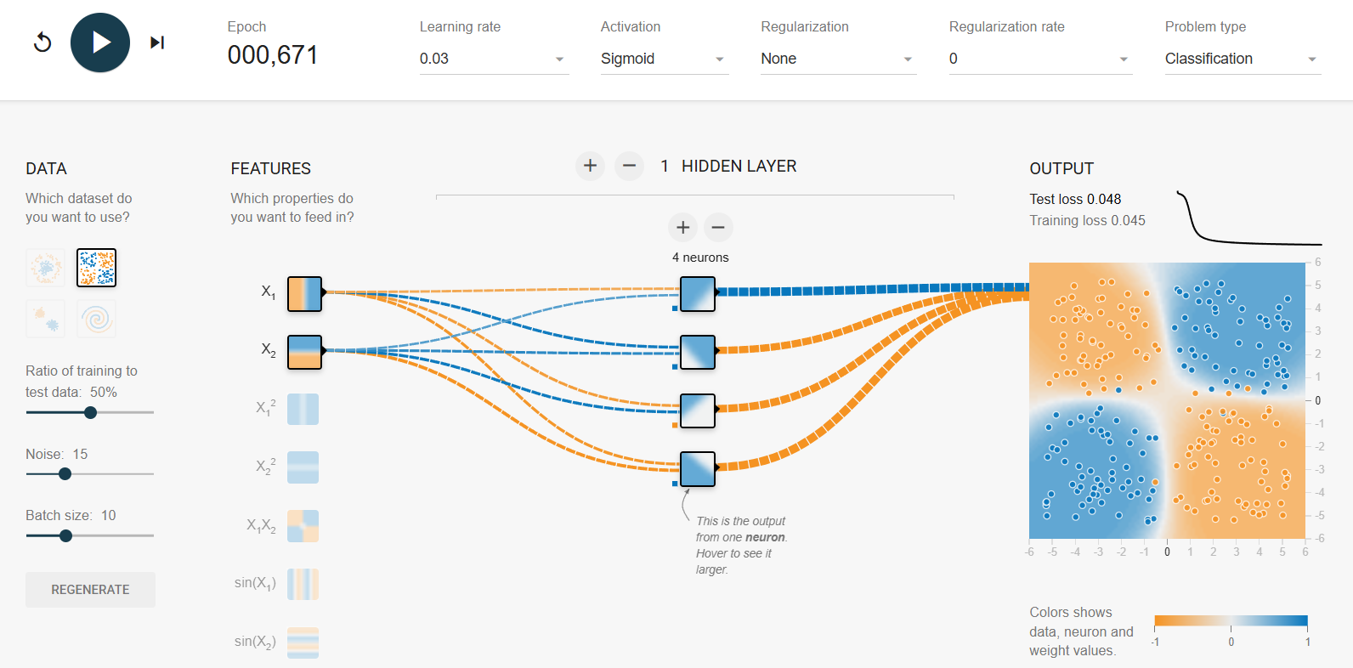
ANN Example
XOR Dataset ANN Architecture

Slide 17



Slide 18
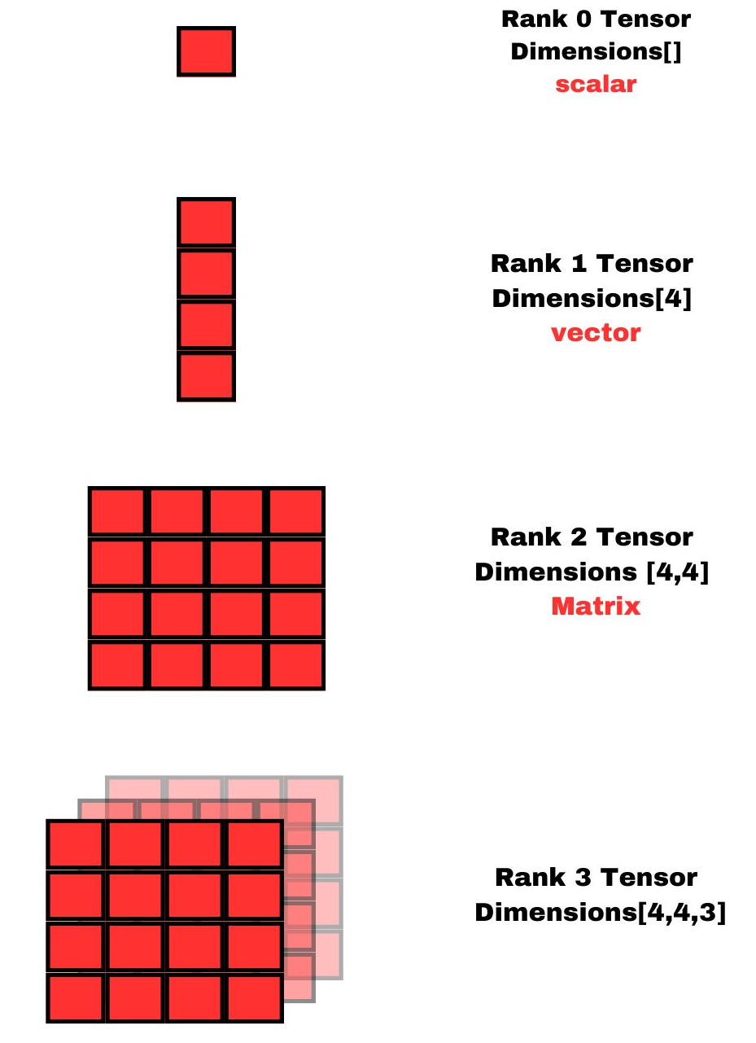
Tensors
Tensor is specialized multi-dimensional array designed for mathematical and computational efficiency.
Types of Tensors:
Scalar (0-D Tensor): Single number
Vectors (1-D Tensor): A list of numbers
Matrices (2-D Tensor): A 2-D grid of numbers
3D Tensor: Coloured images
4D Tensor: Batch of RGB images
5D Tensor: Video data
Review our data and determine which data structure is most suitable for it.
Data looks like [1254(b),120(r),240(c),1(channel)]
For this type of data CNN is a good approach.

Slide 19
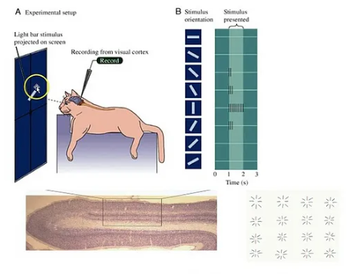
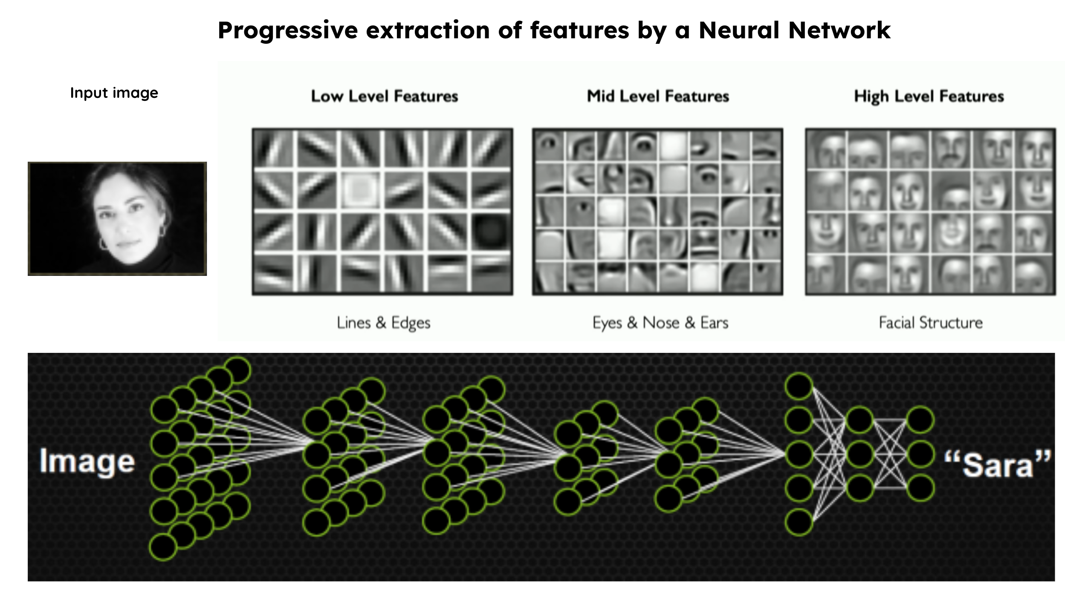
What is a CNN?
Convolutional neural networks are a special kind of neural network for processing data that has a known grid-like topology like time series data(1D) or images(2D). It is inspired by our visual cortex.
Hubel and Wiesel’s famous cat experiment unlocked the mystery.

Slide 20
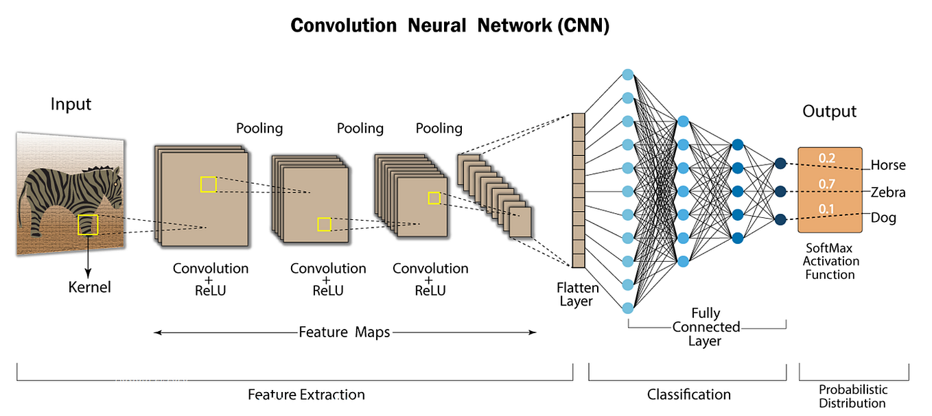
CNN Architecture
CNNs have been split into two parts: Feature Extraction and Classification.
CNNs are built from three basic layers:
Convolution layer
Pooling layer
Fully Connected layer

Slide 21
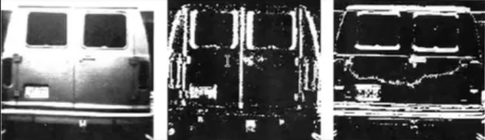



Convolution layer
The convolution layer detects edges and extracts primitive features.
The convolution operation is essential for edge detection.
This is the formula for finding the shape of the feature map $\left(n−f+1\right)∗(n−f+1)$
0 | 0 | 0 | 0 | 0 | 0
0 | 0 | 0 | 0 | 0 | 0
0 | 0 | 0 | 0 | 0 | 0
255 | 255 | 255 | 255 | 255 | 255
255 | 255 | 255 | 255 | 255 | 255
255 | 255 | 255 | 255 | 255 | 255
0 | 0 | 0 | 0
255 | 255 | 255 | 255
255 | 255 | 255 | 255
0 | 0 | 0 | 0
-1 | -1 | -1
0 | 0 | 0
1 | 1 | 1
*
=
Filter/Kernal ($f×f$)
Image ($n×n$)
Feature map

Slide 22




Padding & Strides in Convolution layer
Padding solves mainly two problems:
It remains the image in the same resolution. So you don’t lose the information.
Now border pixels also take the same part as middle pixels do in convolution operation.
This is the formula for finding the shape of the feature map with padding $\left(n+2p−f+1\right).$
Padding means it automatically adds pixel rows on top-bottom and adds pixel columns on left-right with zero values. That’s why it’s also said as zero padding.
Strides is useful when you want high-level features.
Strides reduce the computing power and make it efficient.
This is the formula for finding the shape of the feature map with strides ($\frac{n−f}{s}+1)$ & with padding and stride ($\frac{n+2p−f}{s}+1)$.
Stride value of (2,2) means it skips 2 pixels in right and bottom.

Slide 23


Pooling Operation
There are two main problem that is efficiently solve by pooling operation.
Memory issue
Translation variance
Pooling is used to down-sample your feature map.
There are generally 3 types of pooling layers are used.
Max pooling
Average pooling
Global pooling
Global Max pooling
Global Average Pooling
You will provide 3 parameters which are size, stride, and type.
Used for extracting the dominant features from the feature map.
It has a disadvantage in that it loses approximately 75% of data.

Slide 24

Classification Part
Now, you flatten the last convolution layer and send it to the Fully Connected layer, which is the simple ANN structure.

Slide 25


Enable GPU & Preprocessing
We enable GPU with the ‘cuda’ library.
We preprocess the data.

Slide 26

Data Loader, Dataset,Train-Test Split
We define a class for loading data, which inherits from the built-in Dataset class of PyTorch.
We also set the batch size for the training process.
We take shuffle=False because our data is time series data.

Slide 27



NN Architecture & Training Loop
We define a class that inherits to the nn.Module from Pytorch library of Python.
Choosing Loss function as MSELoss and Adam Optimizer with 0.001 learning rate.
We run the loop for the 50 epochs.

Slide 28


Evaluation
We achieve 91.82% accuracy with our test data.
Also we plot the graph of actual vs predicted.

Slide 29
Problem with CNN
CNNs, while powerful for image recognition, lack the ability to retain sequential information.
This limitation is critical in time series forecasting where models need to leverage historical patterns.
Specialized architectures like Recurrent Neural Networks (RNNs), Long Short-Term Memory (LSTM) networks, and Gated Recurrent Units (GRUs) are used to address this need.
These models capture temporal relationships and update with each time step, making them more effective for tasks involving sequences or time-dependent data.

Slide 30
References
Deep Learning with PyTorch [ELI STEVENS, LUCA ANTIGA, AND THOMAS VIEHMANN FOREWORD BY SOUMITH CHINTALA]
Cat experiment blog
https://playground.tensorflow.org/
100 days of deep learning playlist

Slide 31


